Slide 1
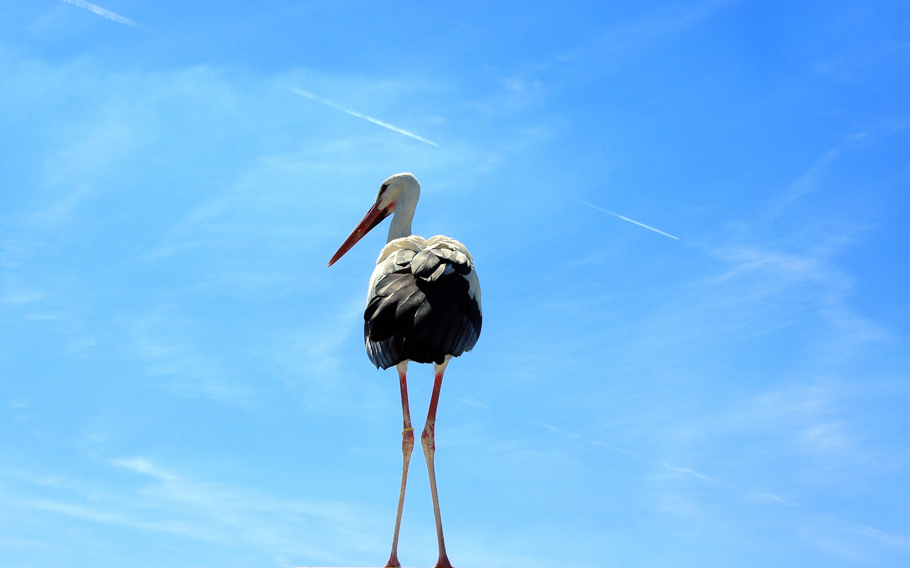
TXT TLK
BQ5 Creativity Lesson 7
I can assess whether social media is ‘dumbing down’ our ability to communicate
Notes:
See how this lesson links to the course by viewing the final slide
Key TOK terms appear in a red font

Slide 2
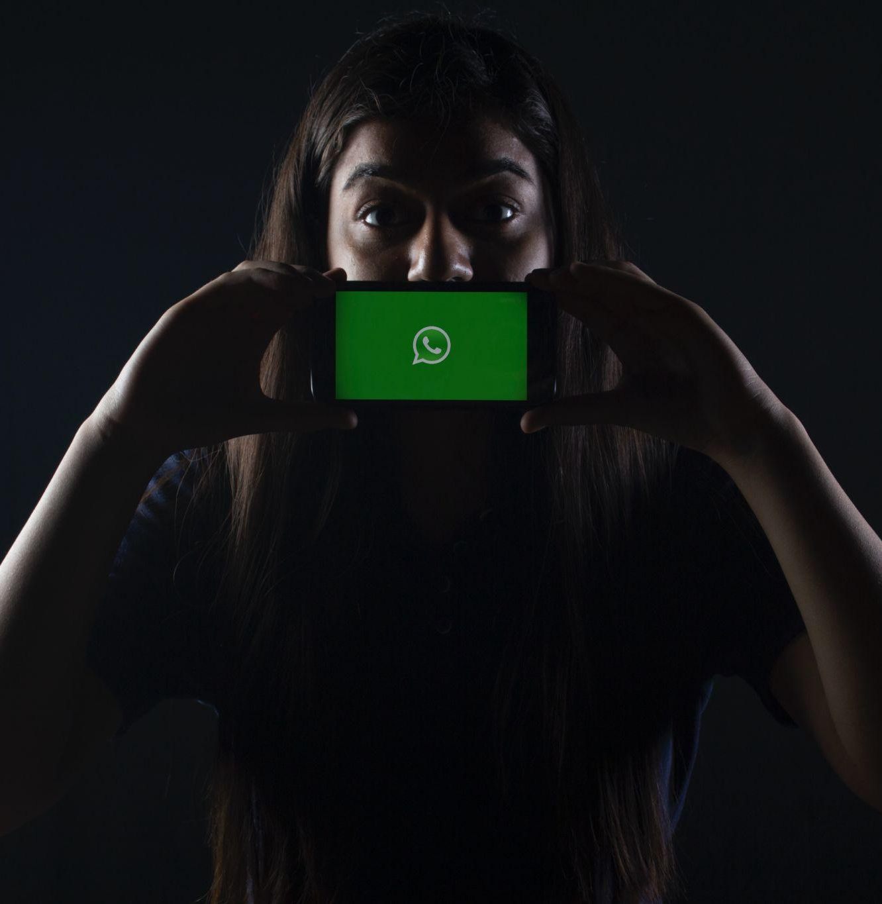
Starter
How do you communicate when you use social media/texting/etc.?
Do you think this has influenced the way you use language when not on social media?
Notes:
Do you use the kind of acronyms and abbreviations from texting when not texting?
Do your friends and peers?
What rules do you adhere to when you are using WhatApp, Instagram, etc.? Eg - being left on ‘seen’!

Slide 3
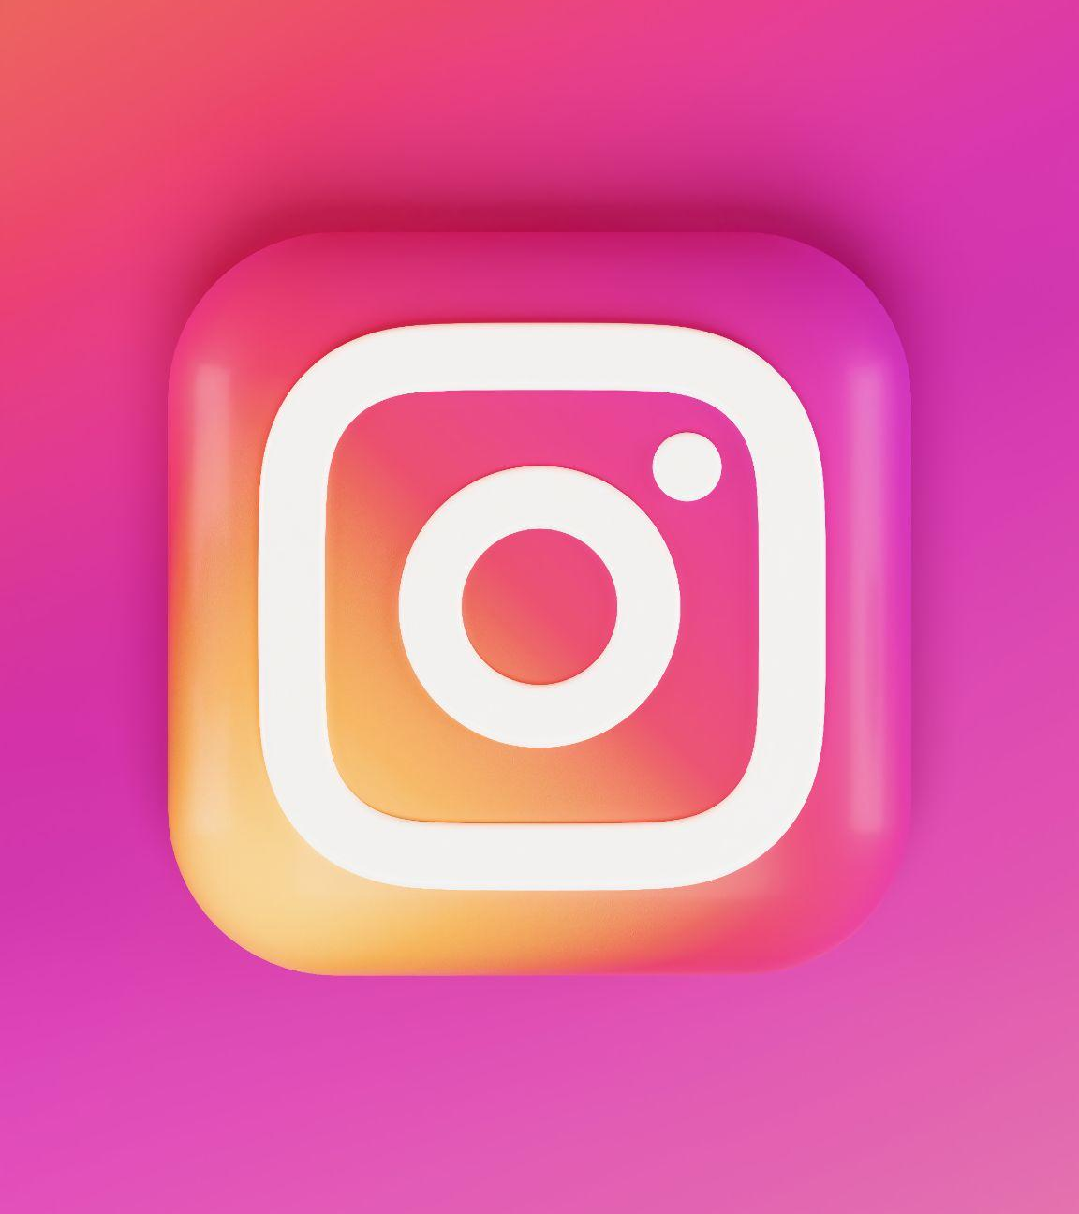
Dumbing down?
Read through Angelo Young’s article.
On one side of your paper, explain what way does he say social media is affecting the way we communicate, and what’s the cause of this?
Notes:
For further (or alternative) research, read this Atlantic article, which extends what Young is saying (and adds a lot of authority to it).

Slide 4
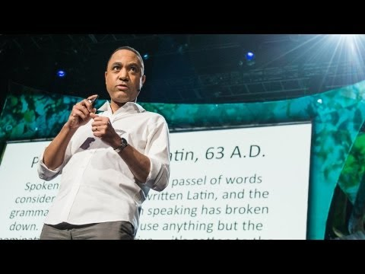
John McWhorter on texting
McWhorter refers to texting as ‘miraculous’.
On the other side of your paper, explain what he means by this, and how it gives us an alternative picture of the way social media has influenced language. Include his distinction between speech and writing.
Notes:
McWhorter’s talk last 13 minutes, and should be watched in full.

Slide 5
The rise of the emoji
Why do think emojis have been so widely widely used to communicate feelings during the COVID-19?
Why does the second article say that emojis have become a ‘cultural phenomenon’?
Does this support what McWhorter was saying about texting being a ‘miraculous’ form of communication?

Slide 6
Links to the TOK exhibition
Related exhibition prompt Can new knowledge change established values or beliefs? (IAP-11)
Refer to the ideas from this lesson to answer this question.
For example, think about the deeply entrenched belief that technology such as WhatsApp, emojis, etc., are dumbing down language, and whether drawing on McWhorter’s ideas can change this attitude.
Which objects could help to illustrate your answer?
Notes:
Optional slide, if you want to help students to take ownership of the IA prompts (IAPs) for the TOK exhibition

Slide 7
Is social media and texting ‘dumbing down’ language?
Explain your answer, with reference to the ideas and terms used by the thinkers we have met today.
Notes:
See the BQ5 assessment tracker for suggestions on providing feedback, and recording students’ progress.

Slide 8
Linking this lesson to the course
During this lesson, we consider the highlighted aspects of the TOK course
The images used in the presentation slides can also give students ideas about selecting exhibition objects; see also our link below to specific IA prompts
CORE THEME | OPTIONAL THEMES | AREAS OF KNOWLEDGE | TOK ASSESSMENT
Knowledge & the knower | Indigenous societies | The arts | The TOK essay
 | Language | History
 | Politics | The human sciences | The TOK exhibition Could be linked to IAP-5 (evidence), IAP-11 (beliefs), IAP-14 (communities).
 | Religion | Mathematics
 | Technology | The natural sciences

Slide 9
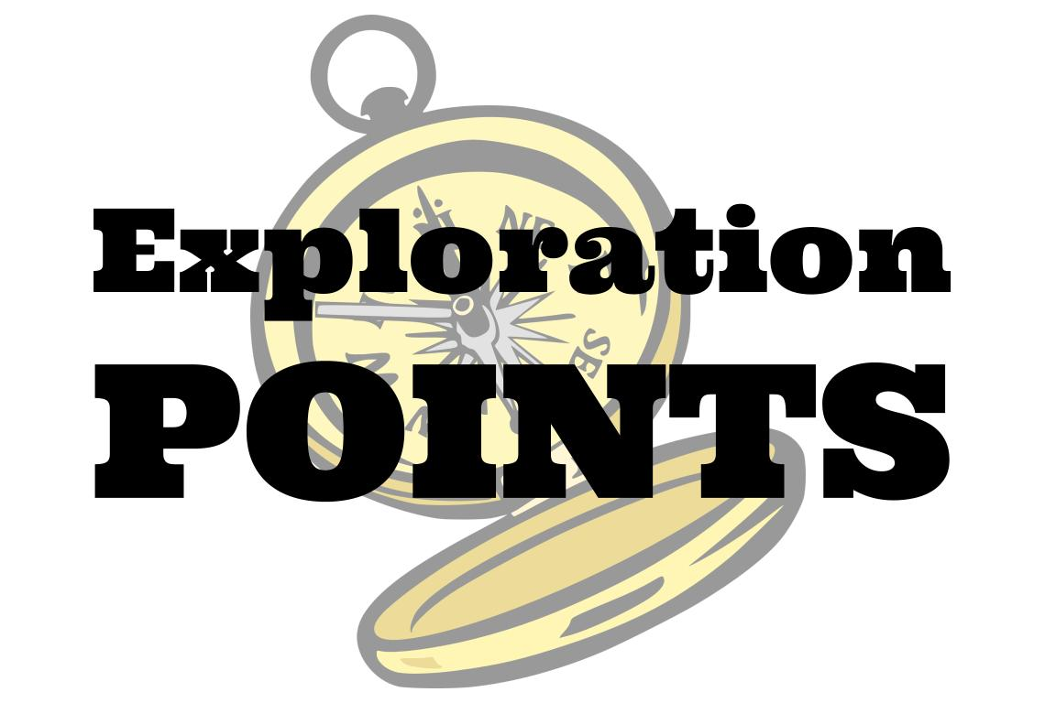
Explore the TOK themes and areas of knowledge in more depth via a range of thinkers, media sources, and other resources, in our EXPLORATION POINTS DOCUMENTS.
Access the documents via the links below. You’ll also find the EP icons on all of the TOK course pages of the site to help you unpack the quotes, KQs, and real-life situations that you find there.
CORE THEME
Knowledge & the knower
OPTIONAL THEMES
Indigenous societies
Language
Politics
Religion
Technology
AREAS OF KNOWLEDGE
The arts
History
Human sciences
Mathematics
Natural sciences
Notes:
Use this slide to access the ‘Exploration Points’ notes for BQ5, which will help students to develop a deeper knowledge of any TOK theme or area of knowledge. This will not only help them to master the TOK course in general, but also craft a great exhibition or essay.
Be ready to provide more guidance on how to use this resource - ie, which media sources to focus on, which questions to address, which TED talks to watch, and which key terms and ideas to understand.

